Slide 1











Exploring LaunchPad: The Ultimate NFT Marketplace for Space Enthusiasts
⥫

Slide 2













About the team
Garvit Arora

Slide 3
Garvit Arora
Computer Science Engineer
CONTACT
Phone: +91 9560849244 Email: garvit.university@gmail.com
Github : Portfolio: https://garvitarora.netlify.app/
I am a first-year B.Tech student at Bhagwan Parshuram Institute of Technology, immersed in a rigorous academic environment that balances theoretical learning with practical application. Proficient in JavaScript and C++, I actively work on projects that enhance my problem-solving skills. My interests lie in web development and data structures, where I strive to apply my knowledge to real-world applications. Passionate about innovation, I am eager to collaborate with like-minded peers and contribute to cutting-edge technological solutions.
ABOUT ME
CPP Problem Solving Frontend Development Blockchain Python Effective Communication Critical Thinking
SKILLS
UI/UX developer & Frontend Developer | INTERN | 2025 - Present ViewThru ClothBuddy LLP
PROFESSIONAL EXPERIENCE
Made the full UI/UX for the Company
Integrated Unique Designs
Collaborated with cross-functional teams to ideate and prototype
Bhagwan Parshuram Institute of Technology | 2024-2028 Bachelor of Technology in Computer Science
EDUCATION
SGPA : 8.8
Recognition for Best Exposure and maintaining good
academics alongside.
Educhain Build Delhi | 2024 Github Website
VAXIFY | 2025 Github Website
PROJECTS
Blockchain Financial Platform | 2024
Github Website

Slide 4
About the team
Lakshay Dawar

Slide 5
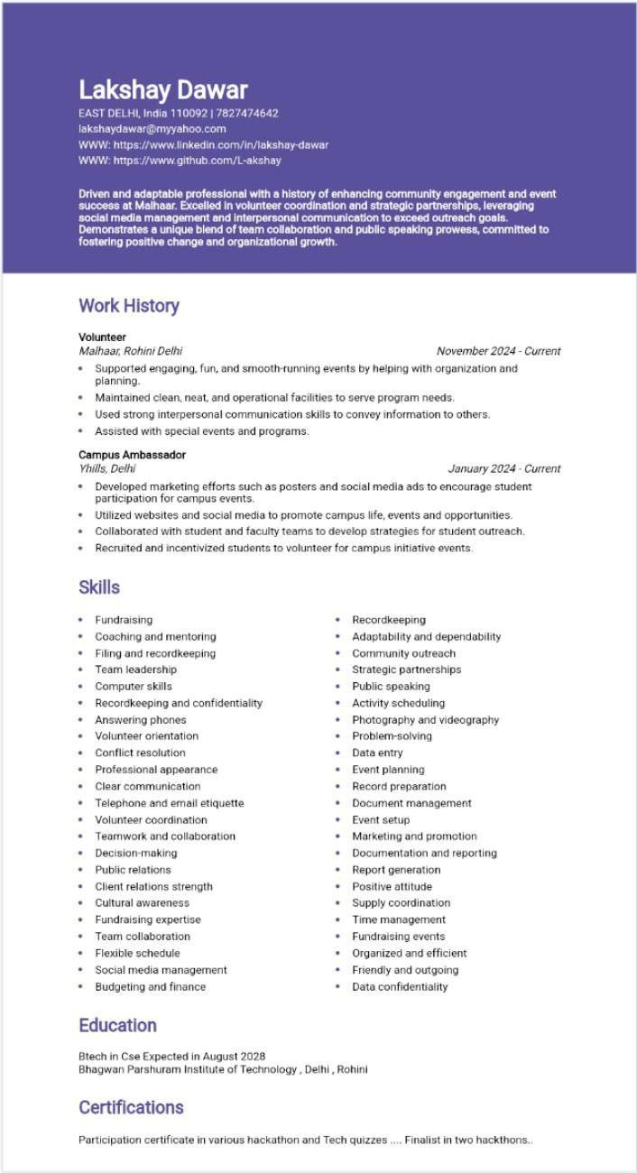

Slide 6
About the team
Asmita Gupta

Slide 7
ASMITA GUPTA
ABOUT ME
I am a btech first year student in Bhagwaan Pashuram Institute of Technology. I am immersed in a rigorous academic environment that emphasizes both theoretical knowledge and practical application. have gained proficiency in languages such as Python and Java, and I am actively engaging in projects that enhance my problem-solving skills. I am particularly interested in exploring web development and data structures, aiming to apply my knowledge to real-world applications. I am eager to collaborate with peers and contribute to innovative technological solutions.
EDUCATION
SECONDARY SCHOOL
BHAGWAAN PASHURAM INSTITUTE OF TECHNOLOGY
BACHELOR OF TECHNOLOGY
BHAGWAAN PASHURAM INTITUTE OF TECHNOLOGY
SKILL
UI/UX DESIGN TEAM COLLABORATION
MARKETING AND PROMOTION Communication
Digital Illustration EVENT SETUP
WORK EXPERIENCE
IIT-ROORKEE PRODUCTHON AI
My team and I -built a Chatbot for Spheron YAML (ICL) Generation. In simple terms, it automates and simplifies
the creation of Interpretable Configuration Language (ICL) files for Spheron, saving developers time and effort
while ensuring precision. In just 24 hours, we transformed an idea into a working AI-driven solution.

Slide 8

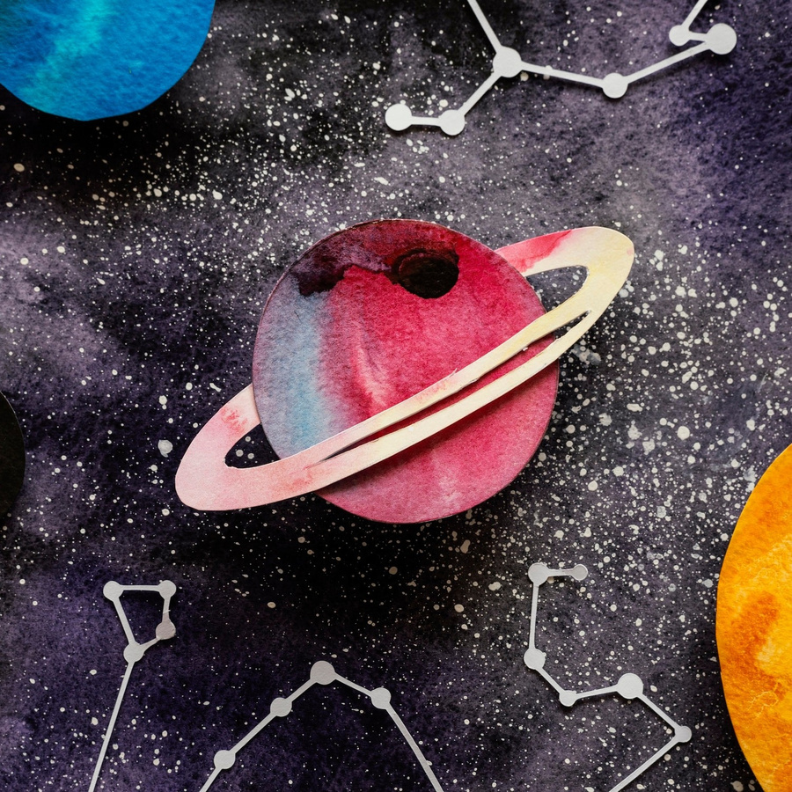






Introduction to LaunchPad
LaunchPad is an innovative NFT marketplace designed speciﬁcally for space enthusiasts. This platform allows users to buy, sell, and trade unique digital assets related to space exploration, astronomy, and more. Join us as we explore the features and beneﬁts that make LaunchPad the ultimate destination for space- themed NFTs.

Slide 9

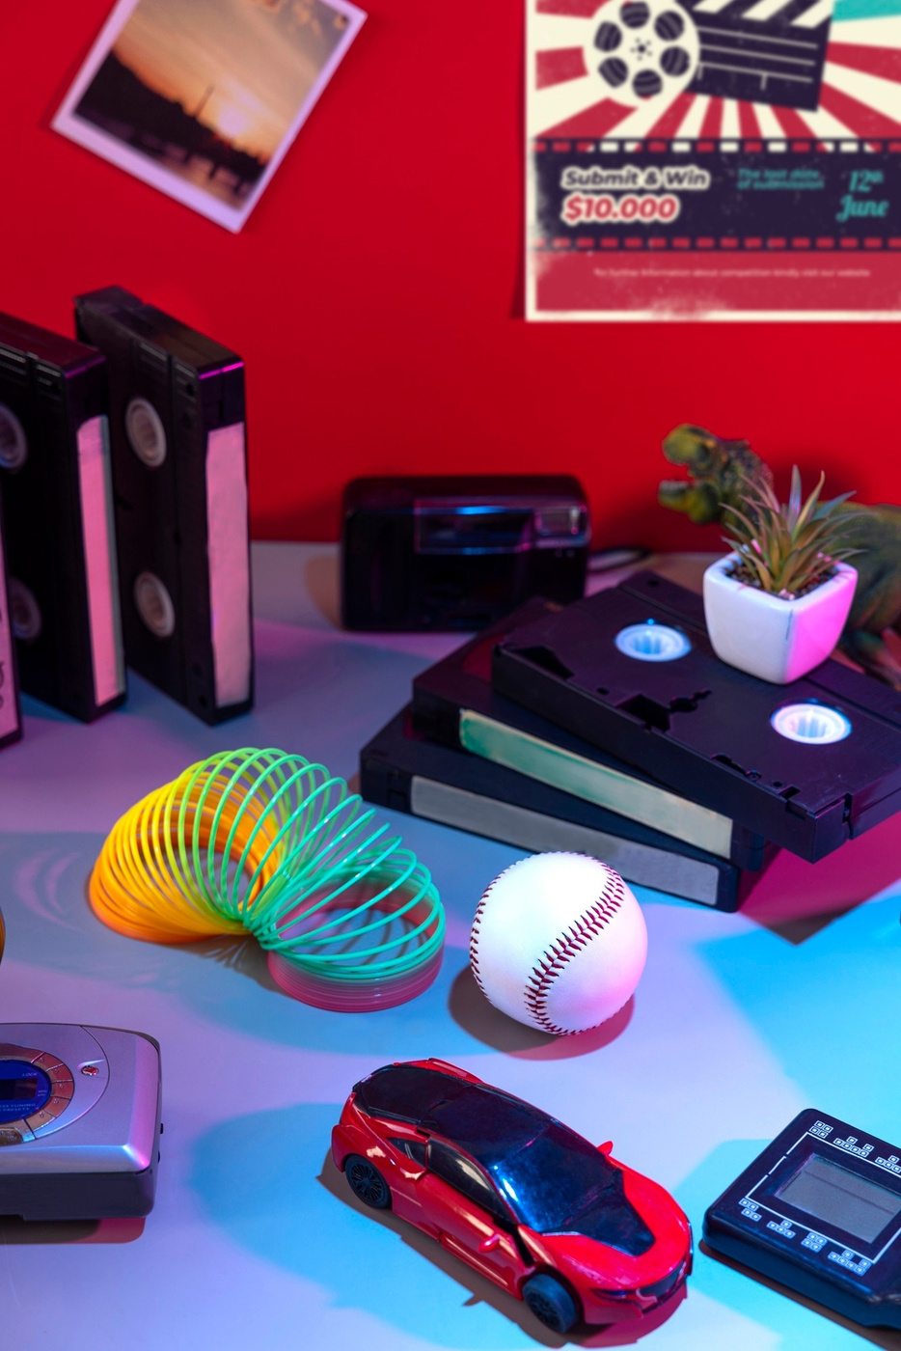








What are NFTs?
Non-Fungible Tokens (NFTs) are unique digital assets that represent ownership of a speciﬁc item or piece of content on the blockchain. Unlike cryptocurrencies, NFTs cannot be exchanged on a one-to-one basis. This uniqueness makes them perfect for collectibles such as art, music, and in this case, space memorabilia.

Slide 10

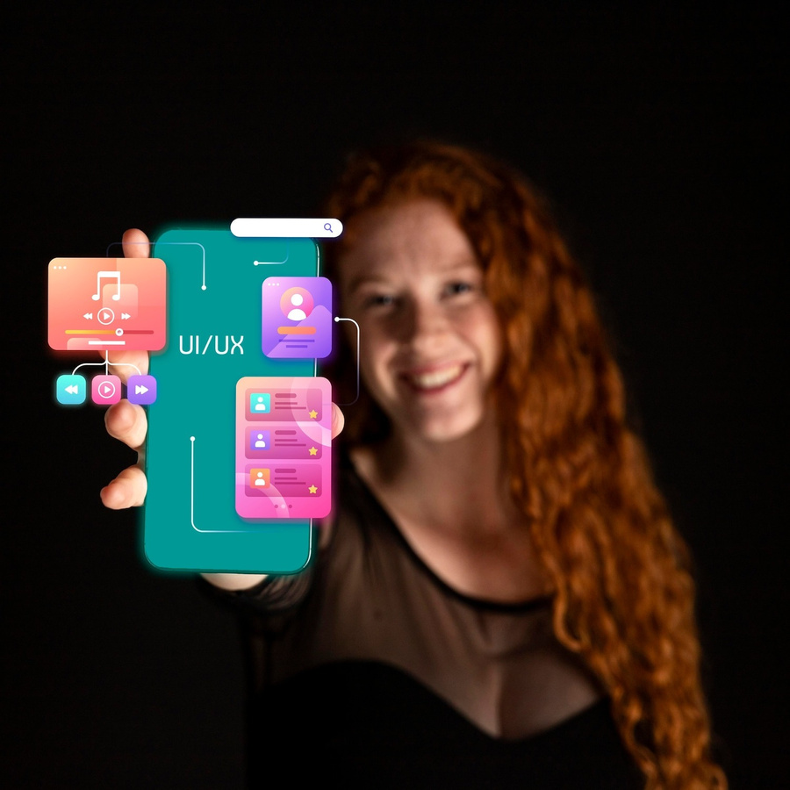
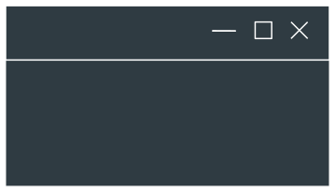









Key Features of LaunchPad
LaunchPad offers several key features that set it apart from other NFT marketplaces. Users can enjoy a user-friendly interface, advanced search options, and secure transactions. Additionally, the platform hosts exclusive drops from renowned space artists and organizations, making it a must-visit for collectors.

Slide 11










Community and Collaboration
At LaunchPad, the community is essential. The platform encourages collaboration between artists, collectors, and space enthusiasts. Users can participate in forums, attend virtual events, and engage in discussions about space, art, and NFTs, fostering a vibrant and supportive environment.

Slide 12

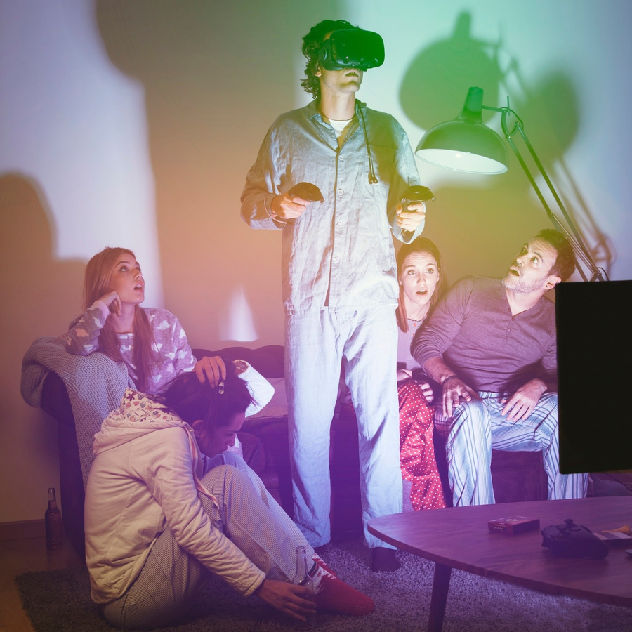






Beneﬁts for Space Enthusiasts
Space enthusiasts can reap numerous beneﬁts from using LaunchPad. The platform provides access to exclusive space-themed NFTs, opportunities to connect with like-minded individuals, and a chance to support artists who share their passion for space. It's more than just a marketplace; it's a community.

Slide 13







Conclusion: Join the Adventure
In conclusion, LaunchPad is the ultimate NFT marketplace for anyone passionate about space exploration. With its unique offerings, community engagement, and commitment to supporting artists, it's the perfect place to dive into the world of space-themed NFTs. Join the adventure today!

Slide 14
Thanks!
Você tem alguma pergunta?
seuemail@freepik.com +91 620 421 838 seusite.com

